Slide 1
Claritin Sentiment Analysis
Presenter: Pankhjn & Mingming Hu
SCS 3253 005 Machine Learning

Slide 2
Agenda
Part1: Introduction
Part2: Data preparation
Part3: Data Exploration & Visualization
Part4:Model Building
Part5:Conclusion

Slide 3
Part 1: INTRODUCTION
Definition of Claritin: is a combination of antihistamine and decongestant used to treat allergies, nasal congestion and sinus pressure.
Problem: The most common complaint is Claritin’s notorious failure rate. It’s not surprising that more serious adverse events (convulsions, heart palpitations, shortness of breathe) – are underrepresented in social media while comparatively minor effects (decreased drug efficacy, allergies worse, nausea) are overrepresented on Twitter relative to FDA reports.
Hypothesis: Total negative score of Claritin Tweet outperform the side Effects reported by drug producing companies to FDA
Adverse Event | Twitter | FDA – PR* | FDA – TR**
Dizziness | 11 | 0 | 16
Convulsions | 0 | 1 | 6
Heart Palpitations | 5 | 0 | 7
Shortness of Breathe | 4 | 0 | 19
Headaches | 7 | 0 | 16
Drug Effect Decreased | 66 | 0 | 3
Allergies Worse After Taking Drug | 132 | 0 | 8
Bad Interaction Between Claritin And Another Drug | 40 | 0 | 5
Nausea | 4 | 0 | 19
Insomnia | 26 | 0 | 9
Other | 0 | 7 | 157
Total | 295 | 8 | 265

Slide 4
Part2: DATA PREPAREATION
Data Set Characteristics: | Multivariate, Text | Number of Instances: | 4900 | Area: | Medicine, Healthcare
Attribute Characteristics | Categorical, Integer | Number of Attributes: | 17 | Date Donated: | Nov 13, 2013
Associated Tasks: | Classification, Clustering | Missing Values: | yes | Techniques: | NLP, Neural Network, SVM

Slide 5
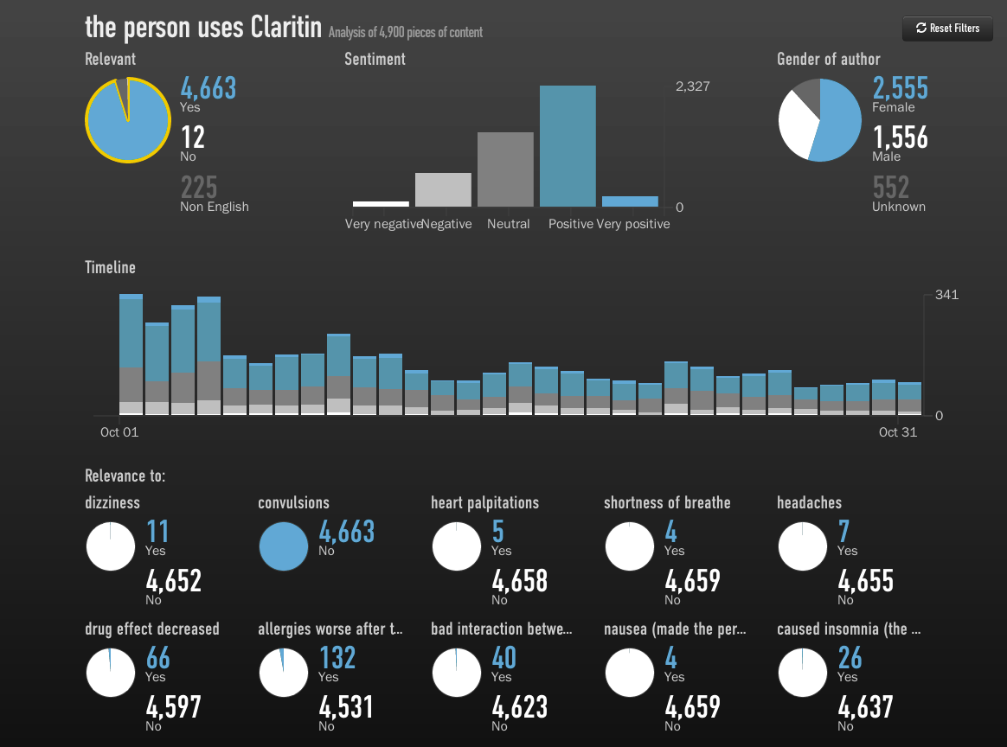

Slide 6
The framework for NLP
Data Collection
Data preprocessing
Data Exploration & Visualization
Model Building

Slide 7
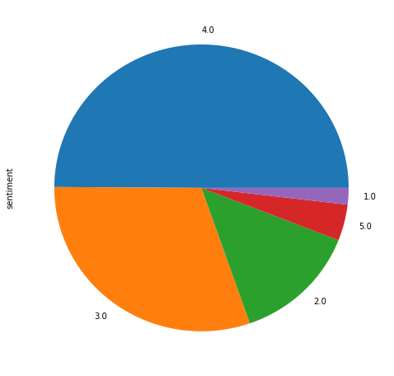
Step 1: Data Collection & Assembly
Data information: www.figure-eight.com/discovering-drug-side-effects-with-crowdsourcing/
Data source: www.figure-eight.com/data-for-everyone
Side effect variables: dizziness, convulsion, heart palpitations, shortness of breathe, headaches, drug effect decreased, allergies_after_drug, nausea, insomnia, bad interaction bw.
The value of them is yes or no.
The sentiment：1 means strong negative opinion and 5 means strong positive opinion.

Slide 8
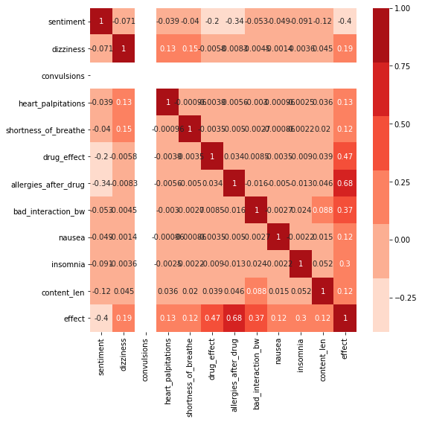
The relationship b/w sentiment and side effect
From the heat map we know that allergies after drug have -0.34 impact sentiment.

Slide 9
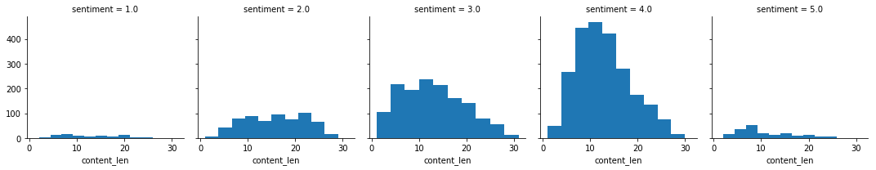
Create variable sentence word-- content_word: The more users estimate sentiment 4 and less users estimate sentiment 1 and 5.

Slide 10
Step 2:Data preprocessing
1. remove the emoji
2. remove the stopwords
3. replace consecutive non-ASCII characters with a space
4. remove http
5. tokenization

Slide 11
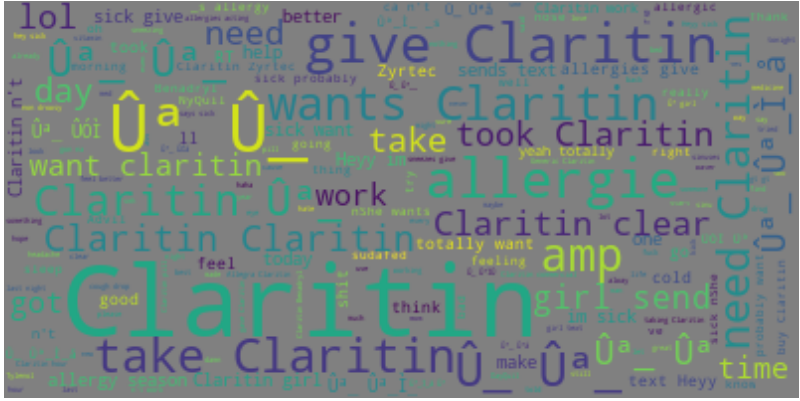
Step 3: Data Exploration & Visualization
1. Generate a sequence wordclound from the word

Slide 12
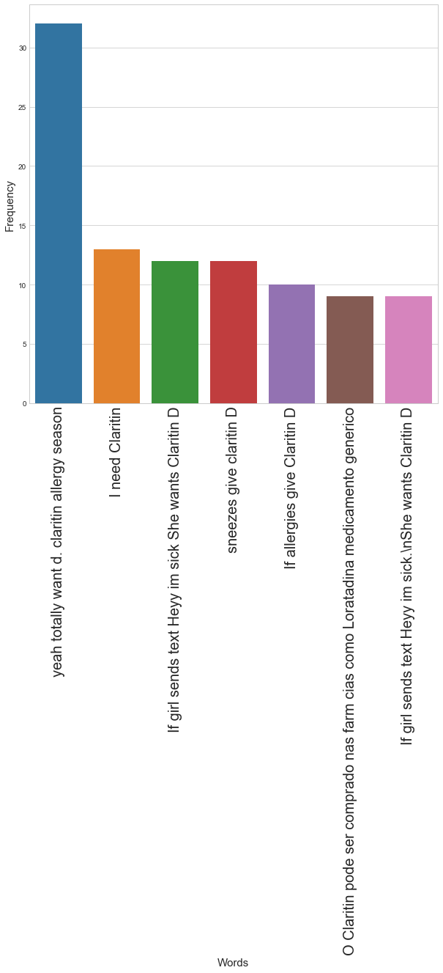
2. Most popular words at content column
a:

Slide 13
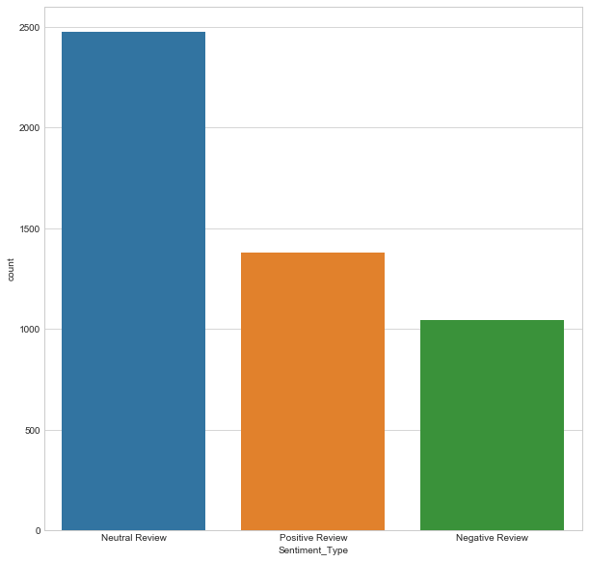
Sentiment function
of textblob

Slide 14
Step4:Modle build
1. Random Forest Classifier applied for model
The result of accuracy is 0.53
2. Multinomial Negative Binomul
The result of accuracy is 0.51

Slide 15
Step 5：Conclusion
Based on our sentimental analysis result, we can provide over 53% accuracy for opinion of Claritin adverse event.
The social media can provide the early warning detection system before premarket.

